Slide 1
DEEP Project presentation 03/03/2014 – Caltanissetta
Donato Bonifazi – DEEP2 Trial Leader
Aurelio Maggio – Trial Coordinating Investigator
Lorella Pitrolo – Principal Investigator

Slide 2
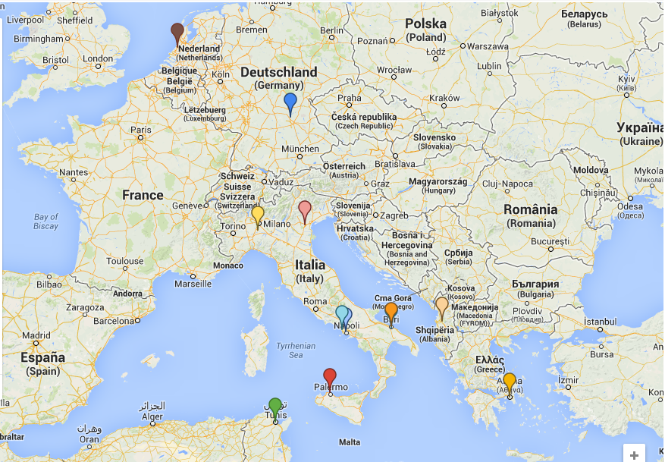
DEEP
Project
DEEP is a multinational reserch project aimed to perform pharmacokinetics, efficacy and safey studies with deferiprone in children
It is funded by the European Commission within the 7° Framework Program
Consortium
Composed of 16 Partners, from Italy, Greece, Cyprus, Egypt, Germany, The Netherlands, Tunisia, Albania and Canada

Slide 3
Goals
to evaluate pharmacokinetics and pharmacodynamics properties of deferiprone in children less than 6 years of age
DEEP1 Paediatric PK Study
to evaluate efficacy and safety of deferiprone compared to deferasirox therapy in 1 month to 17 year-old children affected by hereditary hemoglobinopathies
DEEP2 Paediatric Efficacy/Safety Study
to provide long-term safety data by analysing all events potentially related to deferiprone use (alone or in combination with deferoxamine) in children observed in a time frame of 3 years of clinical practice
DEEP3 Paediatric long term safety Study
According to a Paediatric Investigational Plan (PIP) approved

Slide 4
DEEP-2 (EudraCT 2012-000353-31)
Multicentre, randomised, open label, non-inferiority active-controlled trial to evaluate the efficacy and safety of deferiprone compared to deferasirox in paediatric patients aged from 1 month to less than 18 years affected by transfusion dependent haemoglobinopathies
Phase III study, providing efficacy and safety data after one year treatment with DFP and DFX

Slide 5
DEEP2 Study
Population
344 iron chelator-naïve and non naïve paediatric patients of both genders aged between 1 months to less than 18 years, randomized 1:1 to one of two groups (DFP/DFX) to ensure at least 310 evaluable patients, taking into account a possible dropout rate
Duration
13-14 months
Design
multicentre, randomized, open label, active comparator controlled, parallel group trial
Objectives
to assess the non-inferiority of DFP compared to DFX in terms of changes of ferritin levels and heart iron concentration

Slide 6
DEEP-2 sites
Country | Recruitment Sites
Italy | 12 (2 x Palermo, Padova, Bari, Napoli, Cosenza, Lentini, Modena, Sassari, Cagliari, Firenze, Catania)
Egypt | 1 (Cairo)
Greece | 1 (Athens)
Albania | 1 (Tirana)
Cyprus | 1 (Nicosia)
Tunisia | 1 (Tunis)
UK | 1 (London)

Slide 7
Trial design
Pts assessed for eligibility
(n >= 344)
Excluded
Not meeting inclusion criteria
Declined to participate
Other reasons
Pts randomized
(n = 344)
Pts allocated to DFP (n = 172)
75-100 mg/kg/day liquid formulation for seven days per week
NEW STRENGHT 80 mg/ml
Allocation
Pts allocated to DFX (n = 172)
20-40 mg/Kg/day
Follow-up
Drop-out 10%
Drop-out 10%
Analysis
Pts to be analysed (n = 155)
Pts to be analysed (n = 155)

Slide 8
Visit schedule and evaluations
 | Run in |  |  | Treatment
 | Day |  |  | Baseline Day 0 | Month
 | Screening -28→-8 -7 |  | washout -6→-1 |  | 1 | 2 | 3 | 4 | 5 | 6 | 7 | 8 | 9 | 10 | 11 | 12 | 13 Follow-up
Visit | 1 | 2 |  | 3 | 4 | 5 | 6 | 7 | 8 | 9 | 10 | 11 | 12 | 13 | 14 | 15 | 16
Demographic characteristics | X
Randomization |  |  |  | X
Informed consent | X
Inclusion/exclusion criteria |  | X
Pregnancy test | X |  |  |  |  |  |  |  |  |  |  |  |  |  |  | X
Physical examination | X |  |  | X | X | X | X | X | X | X | X | X | X | X | X | X | X
Medical history and current medical conditions | X
Pharmacokinetics∗ |  |  |  |  |  |  |  |  |  |  |  |  |  |  |  | X
Vital signs | X |  |  | X | X | X | X | X | X | X | X | X | X | X | X | X | X
Liver function history | X
Heart function history | X
Liver MRI∗ |  |  |  | X |  |  |  |  |  |  |  |  |  |  |  | X
Serum Ferritin ∗ | X |  |  | X | X | X | X | X | X | X | X | X | X | X | X | X
ECG | X |  |  | X |  |  | X |  |  | X |  |  | X |  |  | X
Cardiac MRI T2* |  |  |  | X |  |  |  |  |  | X |  |  |  |  |  | X
Urinalysis | X |  |  | X | X | X | X | X | X | X | X | X | X | X | X | X
Renal function | X |  |  | X | X | X | X | X | X | X | X | X | X | X | X | X
Haemoglobin | X |  |  | X | X | X | X | X | X | X | X | X | X | X | X | X
Neutrophil count | X |  |  | X | X | X | X | X | X | X | X | X | X | X | X | X
Hepatitis serology | X |  |  |  |  |  |  |  |  |  |  |  |  |  |  | X
Haematology/ Biochemistry | X |  |  | X | X | X | X | X | X | X | X | X | X | X | X | X
Ocular and audiometric test |  |  |  | X |  |  |  |  |  |  |  |  |  |  |  | X
Concomitant medications |  |  |  | X | X | X | X | X | X | X | X | X | X | X | X | X | X
Medical events |  |  |  | X
Adverse events |  |  |  |  | X | X | X | X | X | X | X | X | X | X | X | X | X
Body height/weight | X |  |  | X | X | X | X | X | X | X | X | X | X | X | X | X | X
Pubertal staging |  |  |  | X |  |  |  |  |  | X |  |  |  |  |  | X
Compliance |  |  |  |  | X | X | X | X | X | X | X | X | X | X | X | X
CHQ questionnaire |  |  |  | X |  |  |  |  |  | X |  |  |  |  |  | X
Healthcare Resources |  |  |  |  | X | X | X | X | X | X | X | X | X | X | X | X
*= Centralized evaluation
Pharmacokinetic
Leiden/Amsterdam Center for Drug Research (LACDR), Leiden, The Netherlands
Liver &Cardiac MRI
MRI Centre, Resonance Health Ltd, Perth, Australia
Centralized serum ferritin
Ferritin Evaluation Centre, Palermo, Italy

Slide 9
Scientific Coordinator
Project Manager
Project Scientific Committee
CLINICAL TRIAL STRUCTURE
(DEEP-2) - DIAGRAM
QUALITY ASSURANCE
TRIAL MANAGEMENT
Responsible for Quality Assurance
PHARMACOVIGILANCE
CRO Representative
Coordinating Investigator
Medical Monitor
QPPV
DSMC
CRO Representative
Principal Investigators
Safety Contact
REGULATORY AND ETHICS
Ethic Board
DRUG MANAGEMENT
Data Manger
CRO Representative
Clinical Research Associates
eCRF
Provider
Responsible for Drug Management
IMP (test) Producer Contact
Biostatistician
MONITORING
Pharmacies
DATA MANAGEMENT AND STATISTICS

Slide 10
Summary
Italy
11 centers: EC approval
9 centers: EC and CA approval
3 already recruiting centers:
Palermo Villa Sofia-Cervello
Napoli Cardarelli
Modena Az. Osp. Universitaria
Tunisia
-EC approval
-CA approval expected in March 2014
Expected EC Submission:➔
Expected EC/CA Approval:➔
Greece | February 2014
Cyprus
Albania
Egypt
UK
Greece | May 2014
Cyprus
Albania
Egypt
UK

Slide 11
Goals
Include all patients within June 2014
12 months experimental treatment
End of trial: June 2015
New strenght will be authorized in the paediatric population

