Slide 1
FP7 Health Program supporting paediatric initiative: the DEEP multinational and multicultural experience
Adriana Ceci
DEEP Scientific Coordinator,
and member of PDCO-EMA

Slide 2
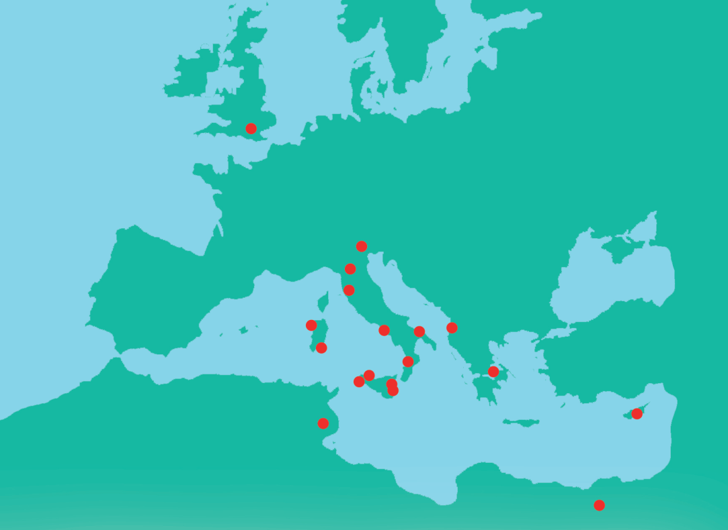
DEEP -DEferiprone Evaluation in Paediatrics
A large research-driven network covering the
‘area’ to which the disease belongs to
DEEP is a 4-year multinational project aimed to make available reliable treatments to children with
beta-thalassaemia, sickle cell disease and other congenital haemoglobinopathies
which represent the most severe forms of anaemia in the world with specific reference to the Mediterranean Area
16 Partners
  18 recruiting centres from 7 Countries:
  EU: Cyprus, Greece, Italy, (UK)
  non-EU: Albania, Egypt, Tunisia

Slide 3
The DEEP project: what’s new
Starting from an old drug, the project aims to perform paediatric studies in order to develop a new liquid formulation specific for the paediatric population and a new paediatric indication
The Project develops
around a full drug developmental Plan (PIP) approved by the European Agency-PDCO that includes:
Liquid Formulation preparation
2 Clinical Trials:
  PK trial providing appropriate dose definition (DEEP-1)
  efficacy-safety multicentre, comparator controlled trial (DEEP-2)
  long-term safety non-interventional study (DEEP-3)
1 post-marketing study
  pharmacoeconomic study
A new Marketing Authorisation (PUMA)
Notes:
to conduct pharmacokinetics, efficacy and safety studies of deferiprone in children

Slide 4
The DEEP project: what’s Innovative
Innovative approaches in CTs: DEEP-1 PK modeling/simulation study to define drug exposure and appropriate dosage of deferiprone for children aged < 6yrs
Inclusion criteria based only on number on transfusional Fe intake without any age threshold
First time comparison between the two oral available comparators: deferiprone vs deferasirox
DEEP-2: the larger RCT in paediatric patients
New, more reliable endpoint based on magnetic resonance:
Cardiac MRI T2* included as co-primary endpoint for children above 10 year and liver MRI-R2 included to measure LIC instead of liver biopsy in all patients not requiring sedation.

Slide 5

The DEEP Project: what’s Challenging
‘Registrative’ CTs with
Economic burden
Ethical stringent provisions
GCP-ICH E11 obligations
Paediatric population
(involves children of different ages)
A rare and disperse
population involving different
Rare Congenital Anaemia
Multi-ethnic population
with different cultures and laws

Slide 6


The DEEP strategy deals with COMPLEXITY
The DEEP multisteps approach
To organize a ‘trials management plan and infrastructure’ including SOPs, data management, drug management, pharmacovigilance, monitoring, etc
To implement a unique procedure and a unique CTA ‘trial submission package’
To develop a ‘patients tailored approach’ involving children, families and association

Slide 7
The DEEP strategy deals with DIVERSITY
STEP 1:
A complex (and expensive) organisational infrastructure has been set up

Slide 8






The legislative context: national rules
in DEEP countries
In EU Countries (Italy, Cyprus and Greece) the Competent Authority authorisation and the Ethics Committee approval is ruled by the Directive 2001/20/EC in terms of CTA form, IMP documents, insurance, informed consent Specific rules for the paediatric population PIP, EMA 2008 recommendations, ICH-E11, etc)
This ‘gold standard’ is to be applied in all centers modified according to the national rules
In Albania specific rules on CTs are lacking; a special decision from the Ministry of Health is needed
In Egypt the CTA is largely similar to Europe, but informed consent procedures are different (i.e. consent from only one parent is accepted- sending samples abroad is regulated)
In Tunisia the Ministry of Health, the National and local ECs shall authorise a paediatric trial
Notes:
*In Italy, Cyprus and Greece the Competent Authority authorisation and the Ethics Committee approval is ruled according to Directive 2001/20/EC in terms of CTA form, IMPs, insurance, informed consent.
*In Albania specific rules on CTs are lacking; a special decision from the Ministry of Health is needed.
*In Egypt the CTA is largely similar to Europe, but informed consent procedures are different.
*In Tunisia the Ministry of Health, the National and local ECs shall authorise a paediatric trial.

Slide 9

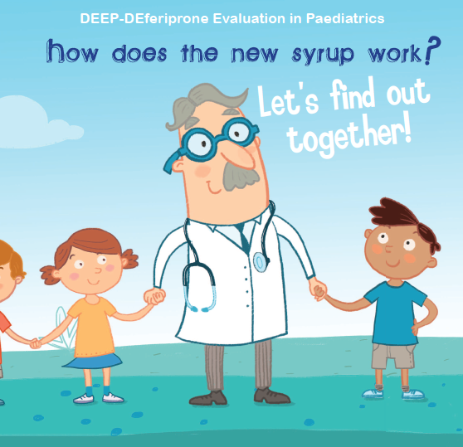
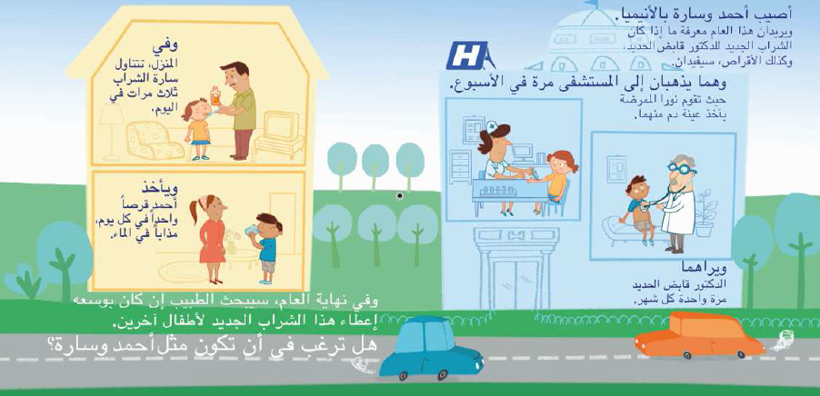
The DEEP strategy to deal with diversity
STEP 3: Patients empowerment in DEEP
Patient-tailored communication model:
3 different BOOKLETS explaining CTs aims and procedures and what they are going to experience
2 different ASSENT FORMS
Translated in the national language:
available in Arabic, Albanian, French, English, Italian, Greek
BOOKLET for the younger ones (under 6 years old)
Notes:
In proportion to age and degree of maturity, the child should participate in the decision-making process together with the parents…

Slide 10
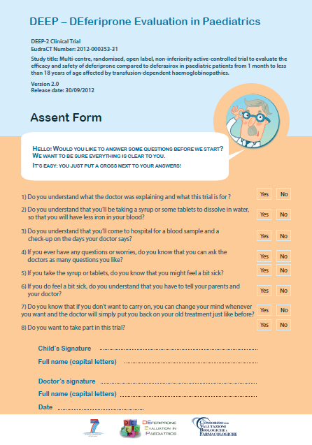
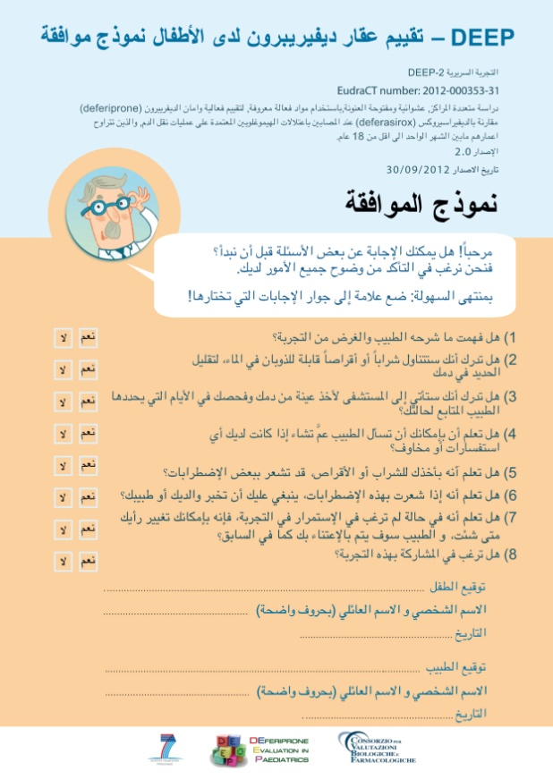
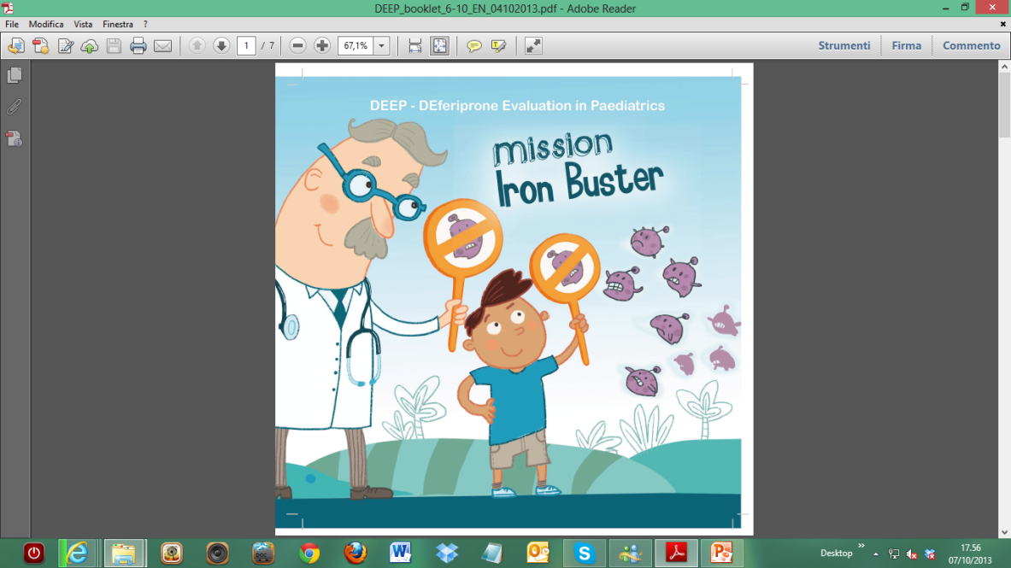
The DEEP strategy to deal with diversity
STEP 3: Patients empowerment in DEEP
BOOKLET and ASSENT FORM for 6-10 years old children
Notes:
In proportion to age and degree of maturity, the child should participate in the decision-making process together with the parents…

Slide 11

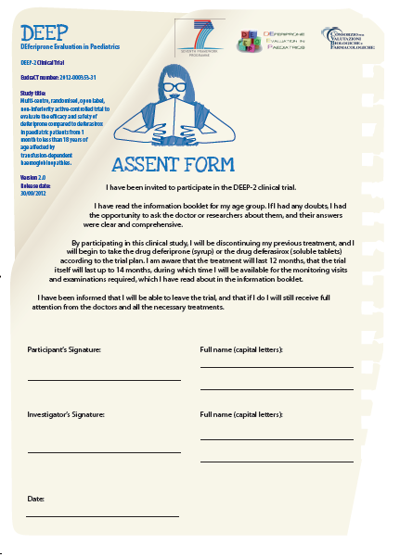

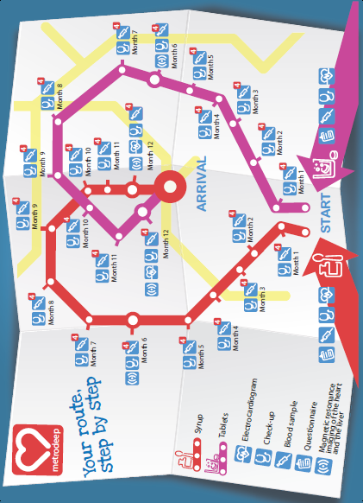
The DEEP strategy to deal with diversity
STEP 3: Patients empowerment in DEEP
BOOKLET and ASSENT FORM for 11-17 years old adolescents
Notes:
In proportion to age and degree of maturity, the child should participate in the decision-making process together with the parents…

Slide 12
Recruitment and approval: the state of the art
New formulation is available to the investigational sites and used in the trials
DEEP-1 is concluding recruitment with success
DEEP-2 approved by the 80% of the Ethics Committees and Competent Authorities and the recruitment is now starting
DEEP-3 observational study is on-going
DEEP is a succes story in the EUROMED perspective

Slide 13

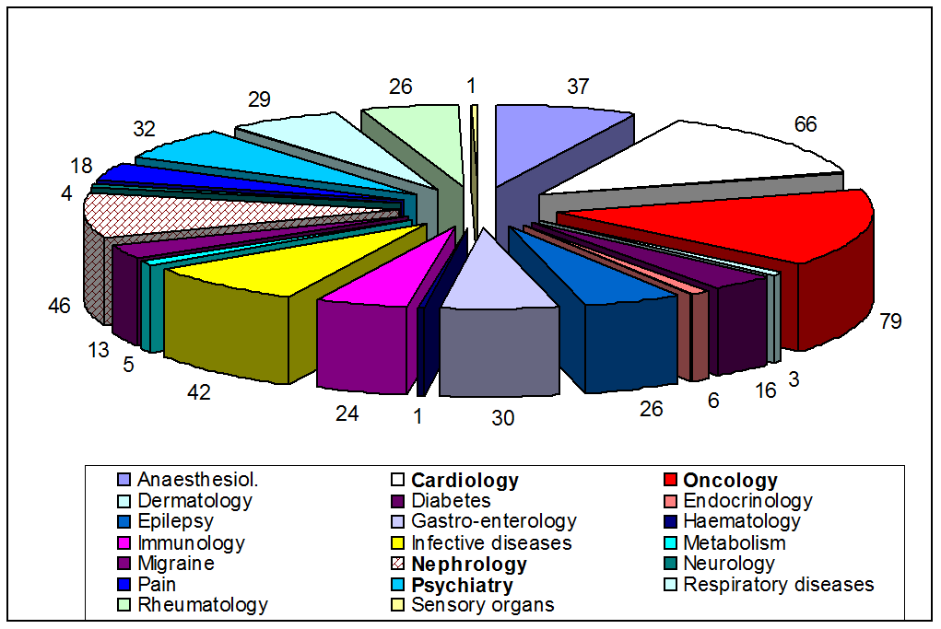
What makes DEEP project so special in the contest of FP7 Projects Framework?
DEEP is aimed to respond to a specific need from the European Union Policies and rules on Paediatric Medicines as stated in the Paediatric Regulation
Less than 30% of Medicines on the market are approved for children. Unapproved drugs are used ‘off-label’ because uncovered therapeutic needs.
DEEP is responding to a real therapeutic need.
This need is a common need in european and no-european MEDITERRANEA REGIONS

Slide 14
The DEEP project: based on scientist excellence located to European/no-European countries
Innovative approaches in CTs: DEEP-1 PK modeling/simulation study to define drug exposure and appropriate dosage of deferiprone for children aged < 6yrs
Inclusion criteria based only on number on transfusional Fe intake without any age threshold
First time comparison between the two oral available comparators: deferiprone vs deferasirox
DEEP-2: the larger RCT in paediatric patients
New, more reliable endpoint based on magnetic resonance:
Cardiac MRI T2* included as co-primary endpoint for children above 10 year and liver MRI-R2 included to measure LIC instead of liver biopsy in all patients not requiring sedation.

Slide 15
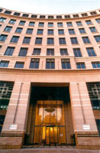
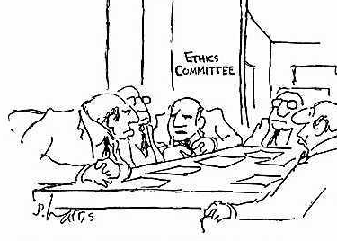

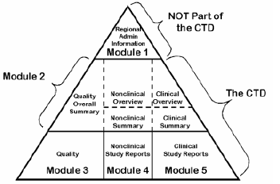
DEEP demonstrate to be able
Commercial Sponsor
Intellectual Property
FP7 application
PIP application
PUMA Applications
Project considered on the basis of scientific excellence (no paediatric needs)
No mention to the trials conduct
Very few preclinical studies funded
Research Consortia having no experiences in regulatory process
A whole research & development plan requested.
All paed. subsets should be covered
Details of timing & measures including preclinical, formulation
Efficacy, Safety

Slide 16
The lesson learnt from these projects
In response to the EC Research policies
  Networking action: a very large scientific community is sharing competencies and skills.
  Pubblic-private integration and support to SMEs
In response to the specific topic (Paediatric Medicines:
  Development of Paediatric Plans (PIPs available for 15 Active Substances)
  Consistent number of paediatric patients, also neonates, in the trials
  An appropriate drug for treating iron overload in children
In response to the Scientific Community expectations
  Innovative elements included in the trials: pharmacogenetic studies
  New competencies acquired (Regulatory, trials managements, Ethics, Communication with parents/patients, etc)

Slide 17

Conclusions
Is DEEP Research CONSORZIUM qualified to apply for?
•Excellent Science
•Industrial Leadership
•Societal Concerns
Health, demographic change and wellbeing

